Slide 1
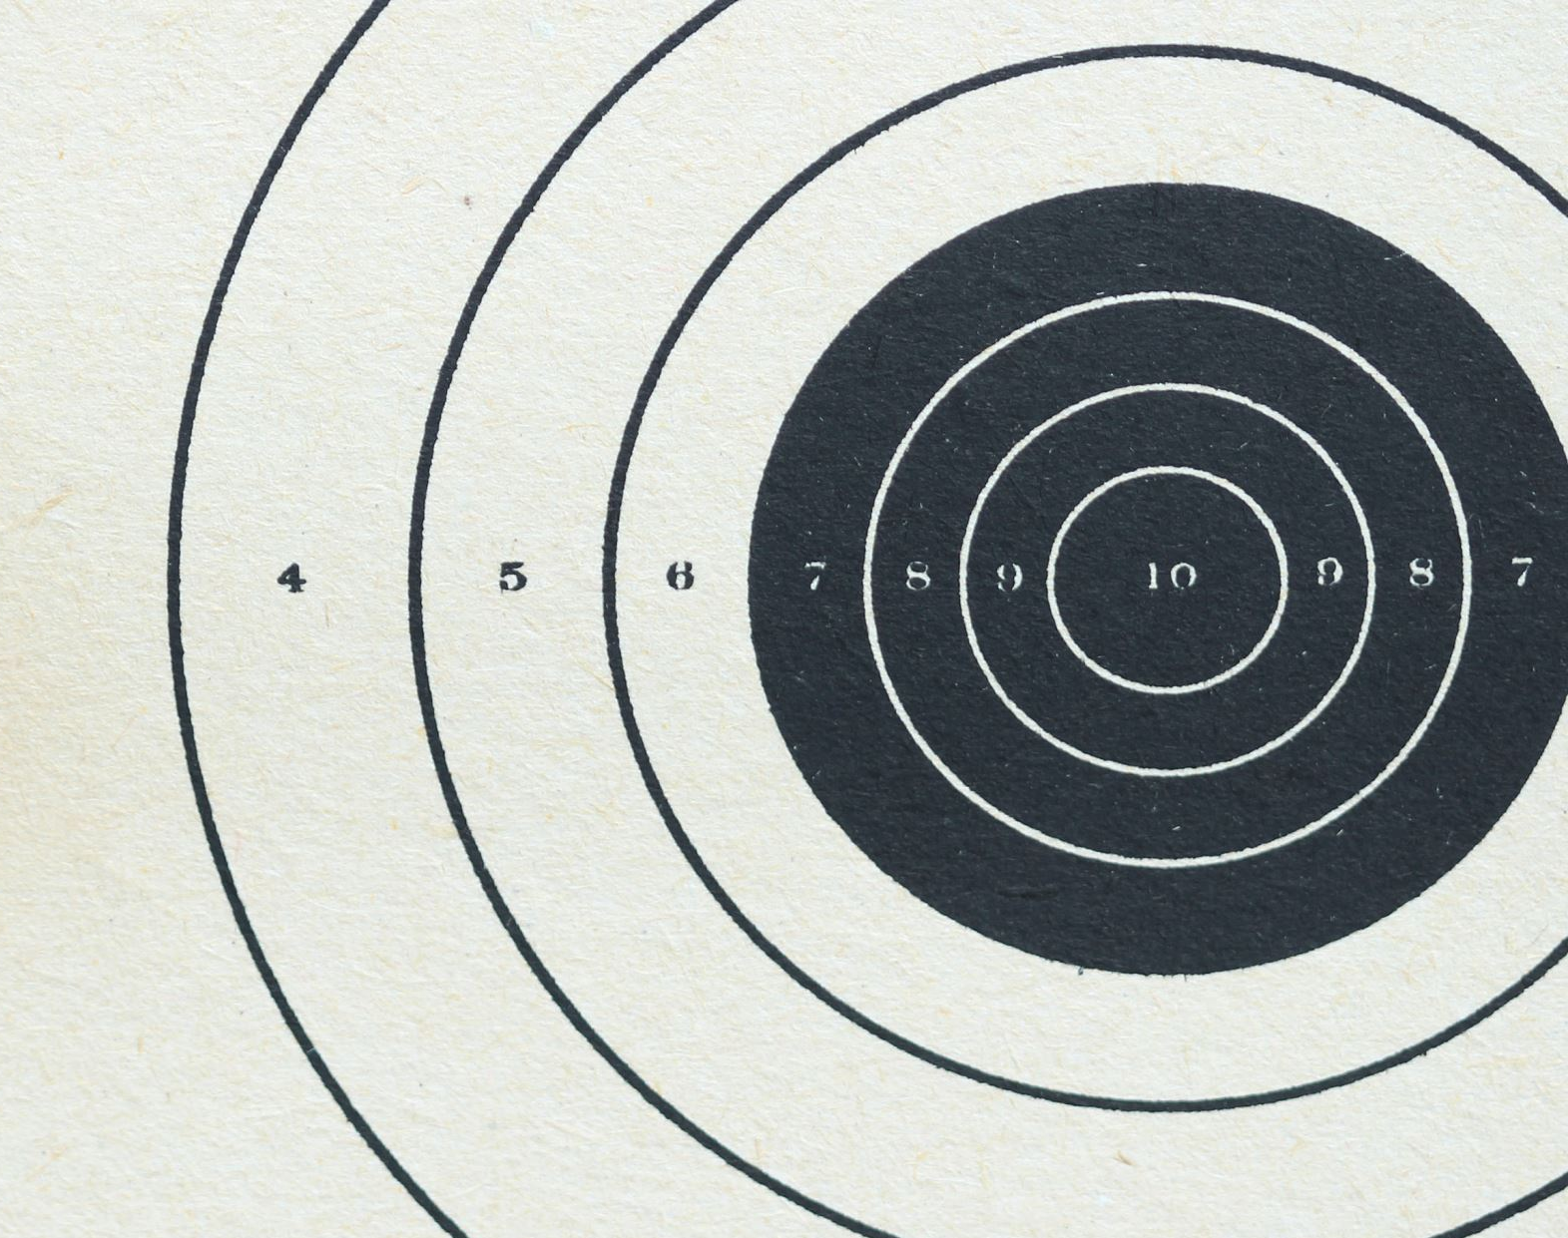
Accuracy Trend with Different Image Sizes and Contrast

Slide 2
Compare between part whole test and part whole flip test
Trend with different image sizes

Slide 3
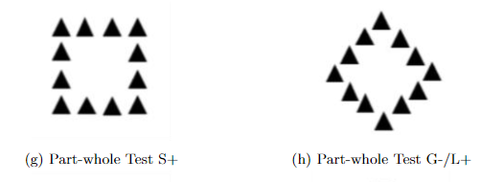
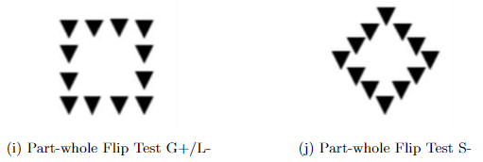
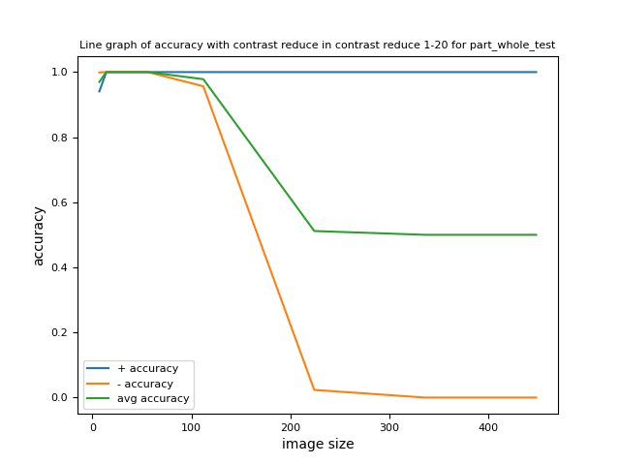
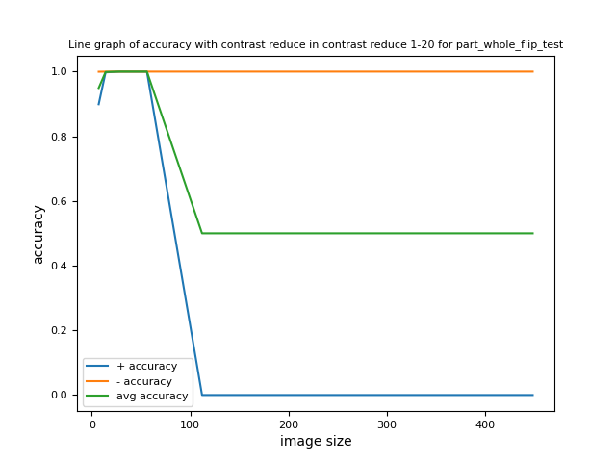
Compare with different image sizes
Image pixel values are binary, either 0 or 255.
Contrast reduce 1-20 means when pixel value equals to 255, it deducts a random integer between 1 and 20.
When pixel value equals to 0, it adds a random integer between 1 and 20.
Image sizes include 7*7, 14*14, 28*28, 56*56, 112*112, 224*224, 336*336 and 448*448.

Slide 4
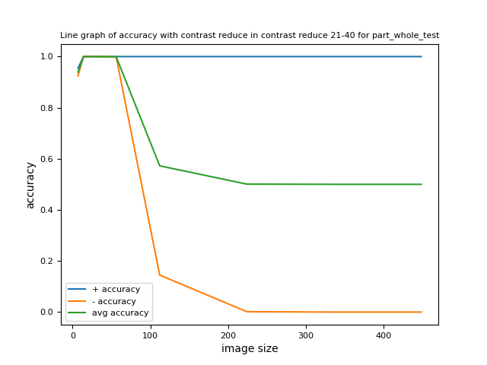
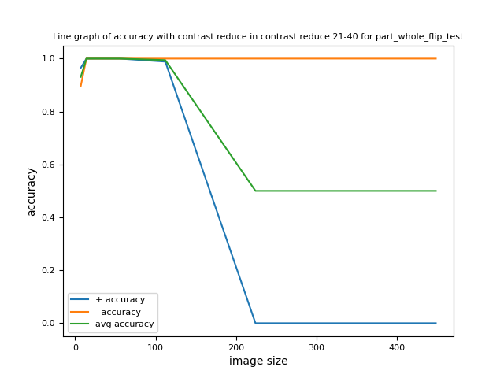
Compare with different image sizes
Part whole test and part whole flip test have the same global feature but have different local feature.
The local feature triangle is flipped in part whole flip test.
The model tends to classify the image according to the local feature when image size is higher than 56*56.
In part whole test, the model tends to classify all images as plus when image size is higher than 56*56.
In part whole flip test, the model tends to classify all images as minus when image size is higher than 112*112.

Slide 5
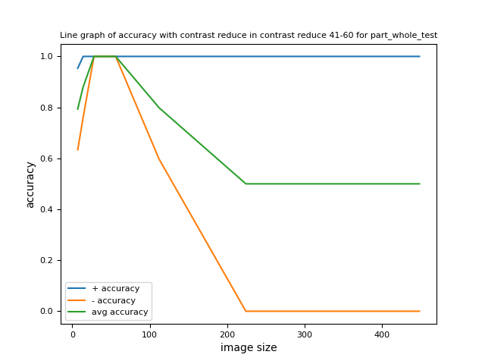
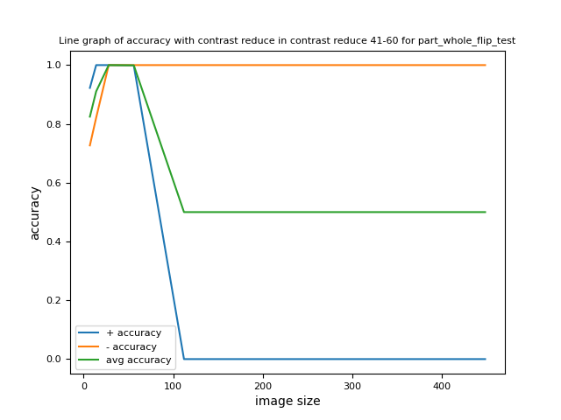
Compare with different image sizes

Slide 6
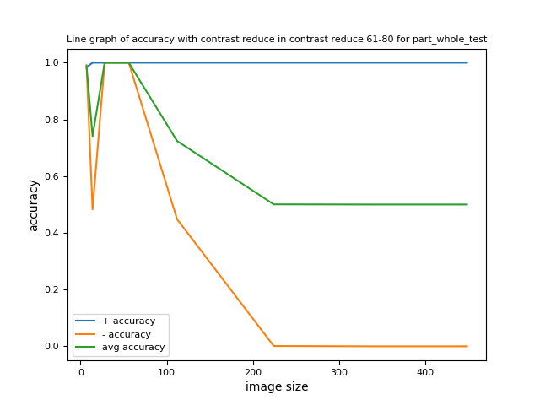
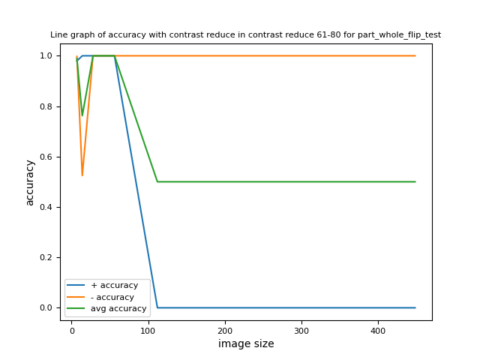
Compare with different image sizes

Slide 7
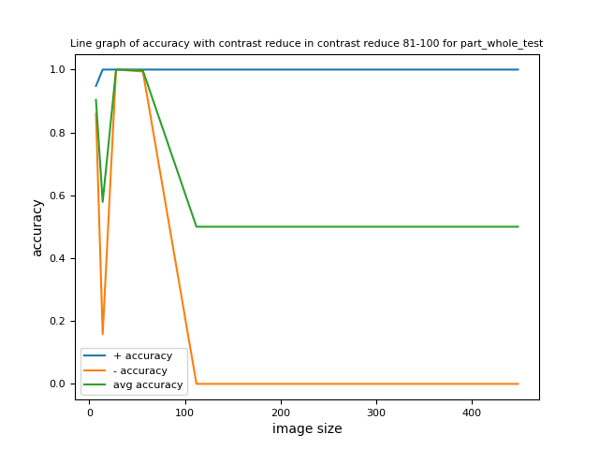
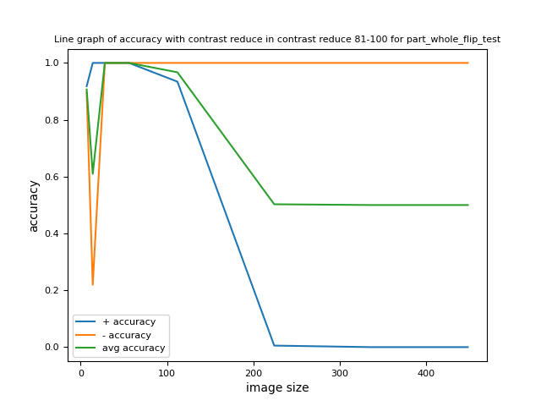
Compare with different image sizes

Slide 8
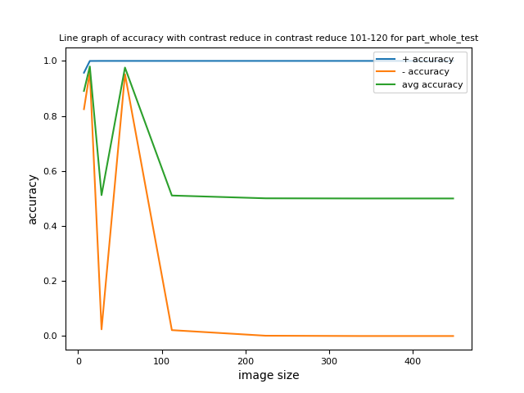
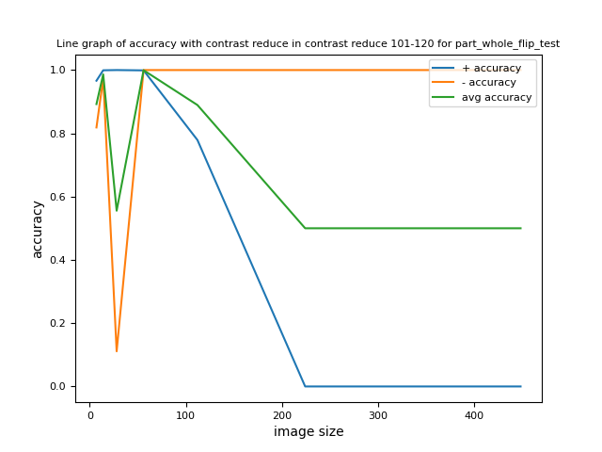
Compare with different image sizes

Slide 9
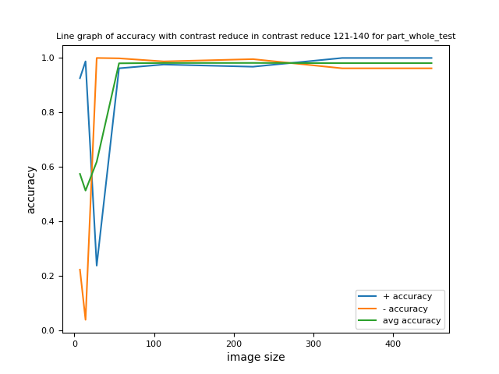
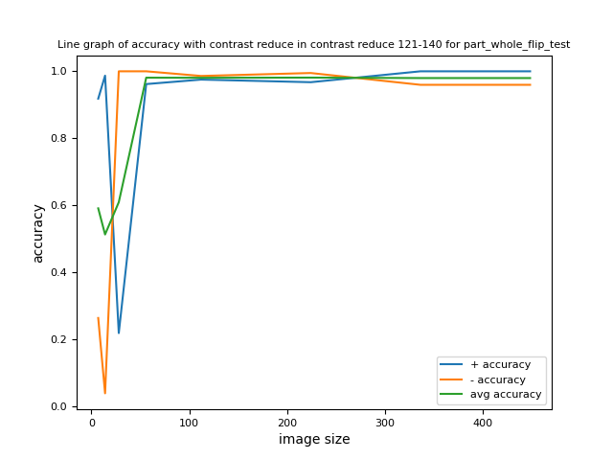
Compare with different image sizes
When image contrast is very low (contrast reduce 121-140), the model tends to have high accuracy when image size is larger than 56*56.
Images with contrast reduce 121-140 have the lowest contrast.
When image size is larger than 56*56, low contrast tends to have high accuracy. While when image size is lower than 56*56, high contrast tends to have high accuracy.

Slide 10
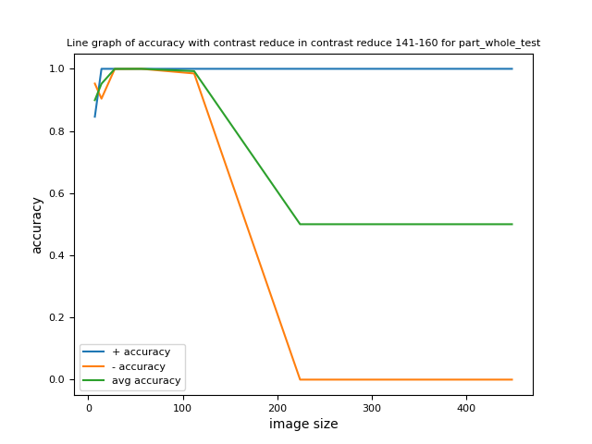
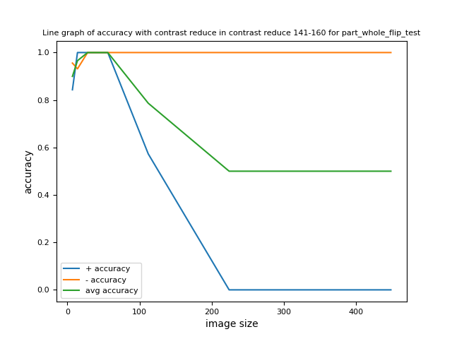
Compare with different image sizes

Slide 11
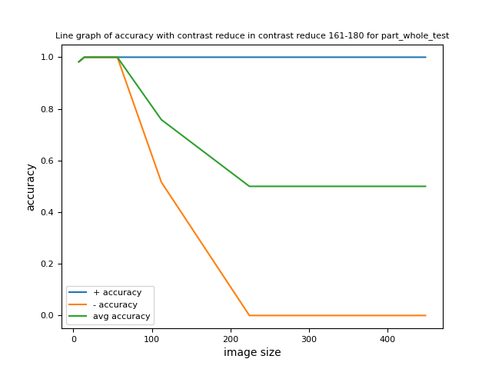
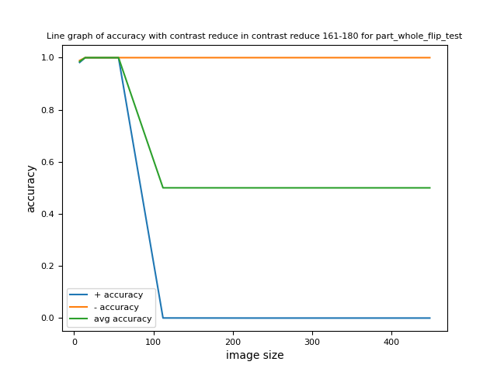
Compare with different image sizes

Slide 12
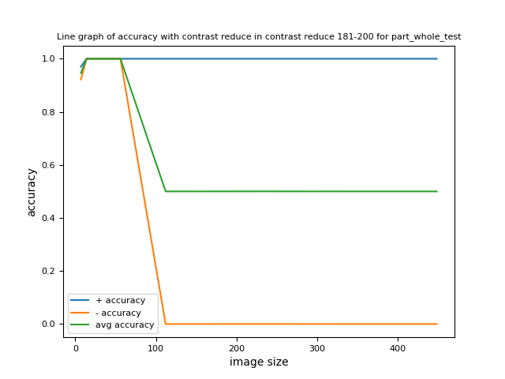
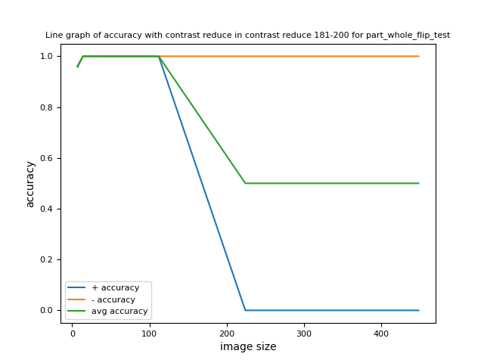
Compare with different image sizes

Slide 13
Compare between part whole test and part whole flip test
Trend with different contrast reduce

Slide 14
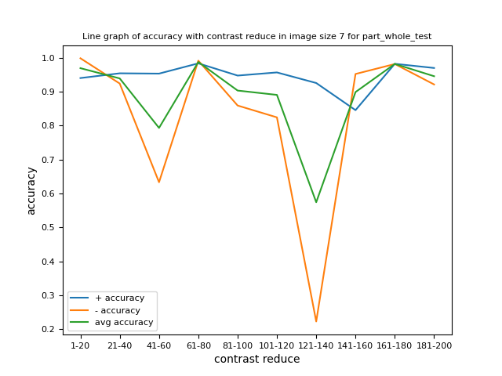
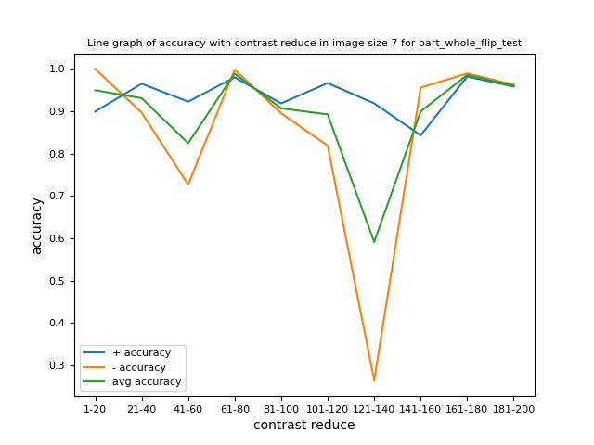
Compare with different contrast reduce
Contrast reduce 121-140 has the lowest contrast

Slide 15
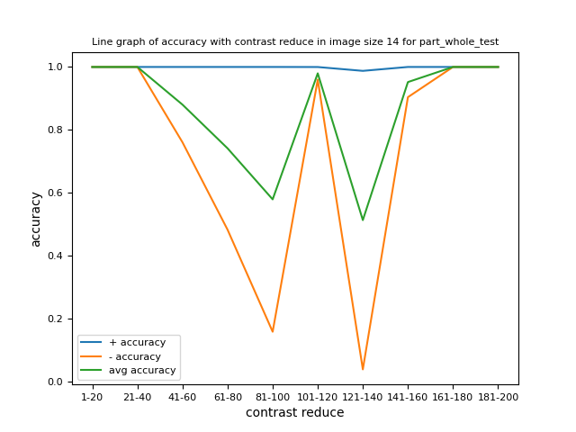
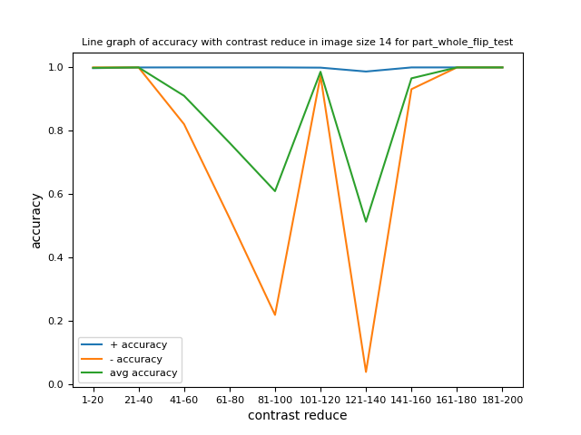
Compare with different contrast reduce

Slide 16
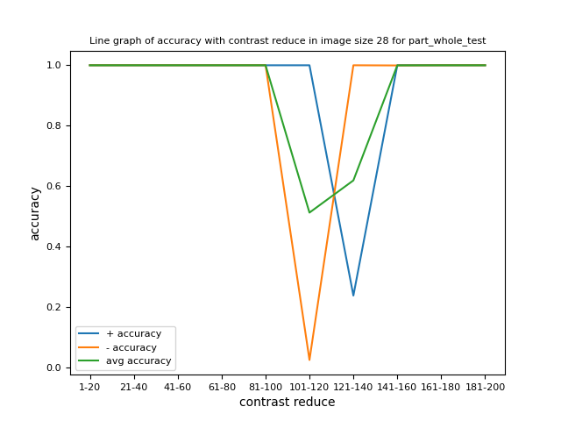

Compare with different contrast reduce

Slide 17
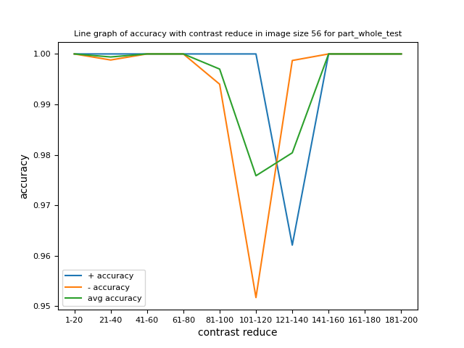
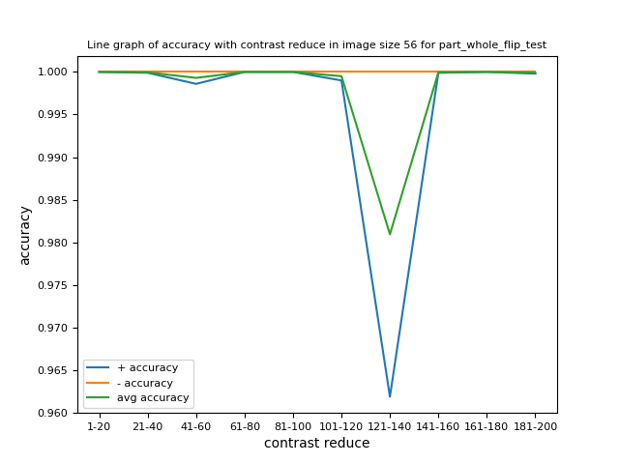
Compare with different contrast reduce

Slide 18
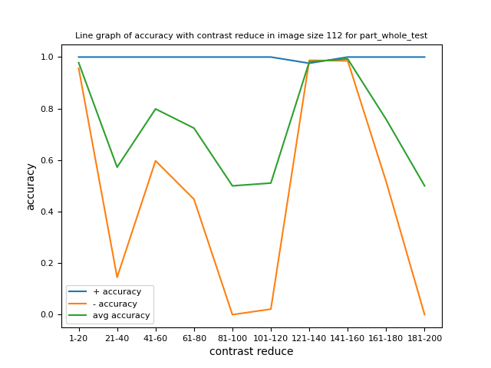
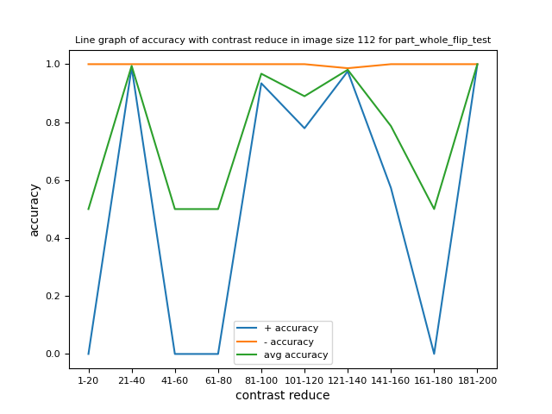
Compare with different contrast reduce
The model tends to classify the image according to the local feature when image size is higher than 56*56.
In part whole test, the model tends to classify all images as plus when image size is higher than 56*56.
In part whole flip test, the model tends to classify all images as minus when image size is higher than 112*112

Slide 19
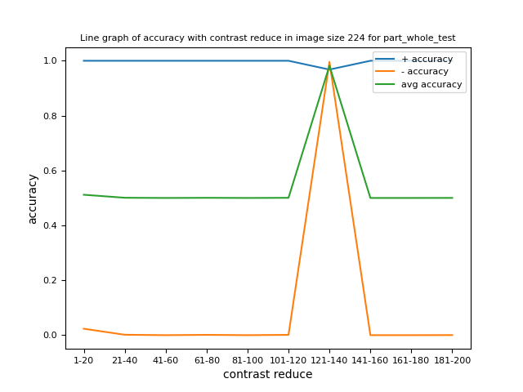
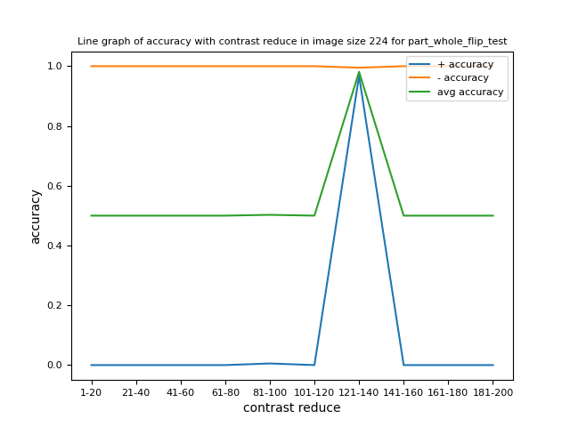
Compare with different contrast reduce
When image contrast is very low (contrast reduce 121-140), the model tends to have high accuracy when image size is larger than 56*56.
Images with contrast reduce 121-140 have the lowest contrast.
When image size is larger than 56*56, low contrast tends to have high accuracy. While when image size is lower than 56*56, high contrast tends to have high accuracy.

Slide 20

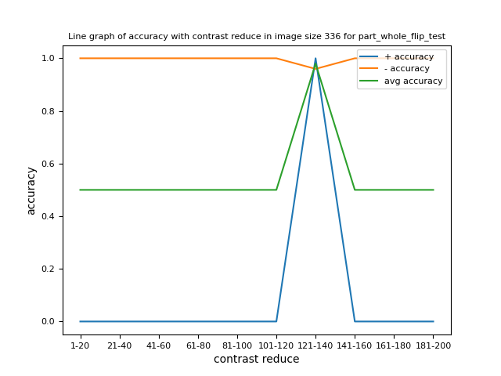
Compare with different contrast reduce

Slide 21


Compare with different contrast reduce

Slide 22
Compare between different image sizes
Trend with different contrast reduce

Slide 23
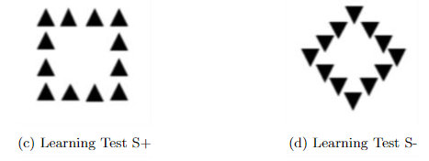

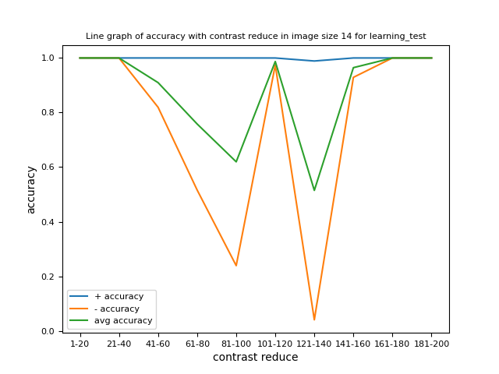

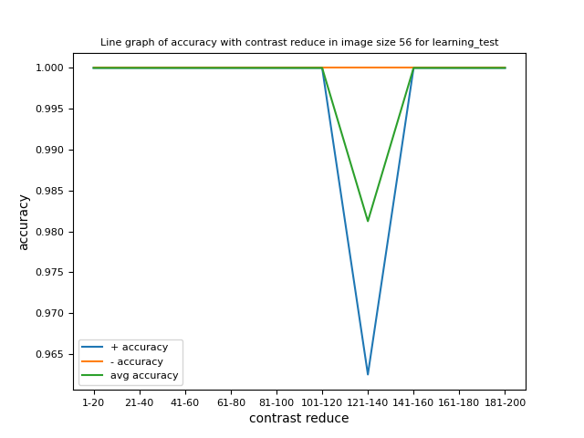
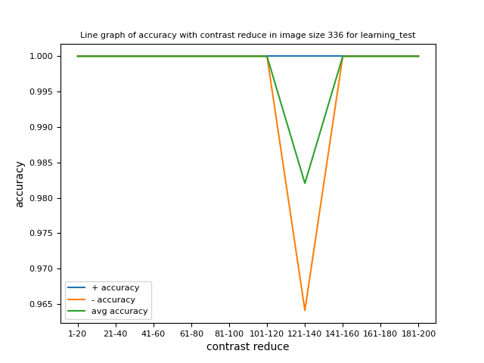

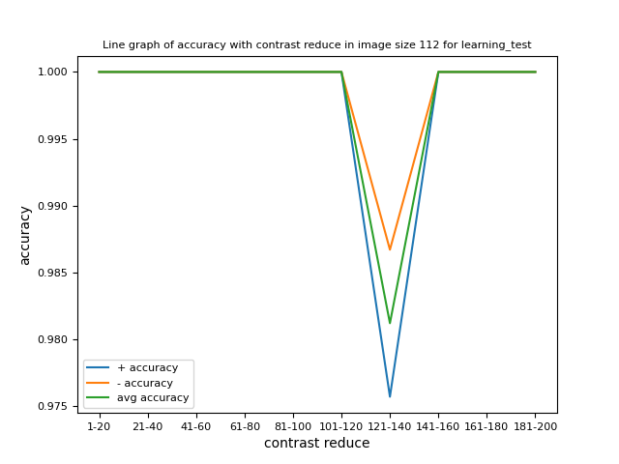
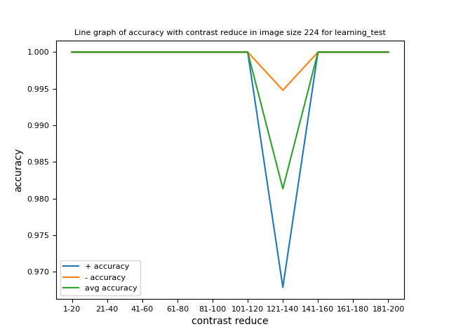
Learning test trend with different contrast reduce for different image sizes
Learning test is with the same pattern as the training dataset.
When image size is less than 28*28 (included), in low contrast (contrast reduce 121-140), it cannot classify the learning test.

Slide 24
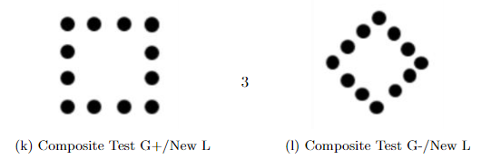
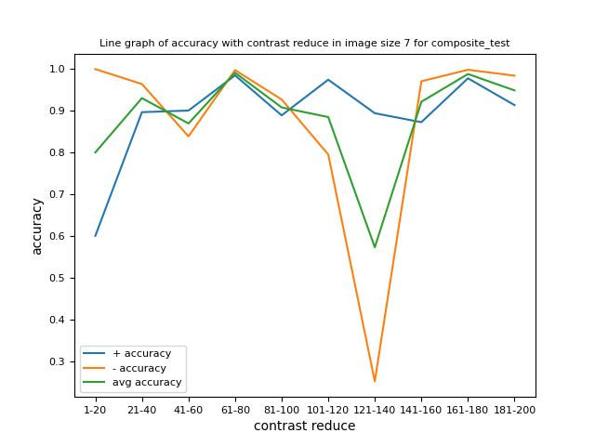
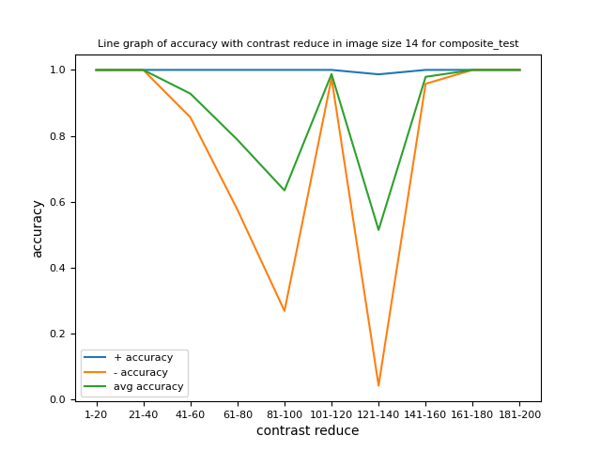
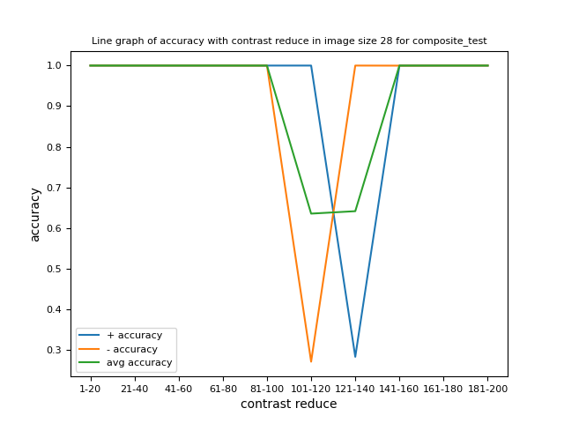

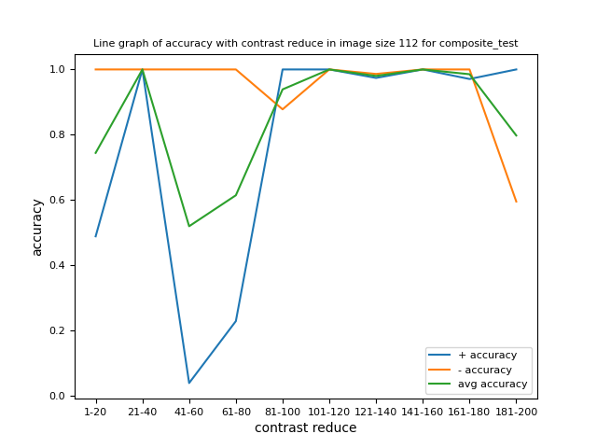
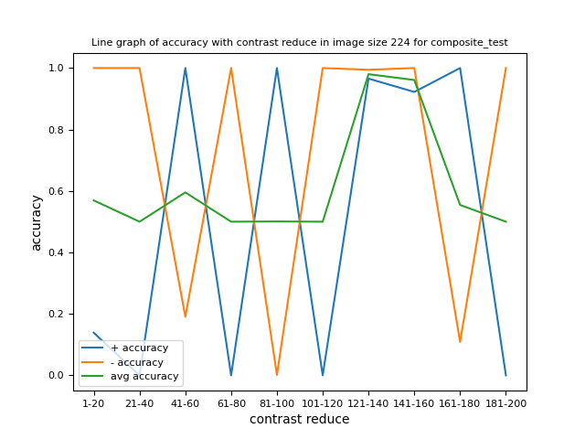
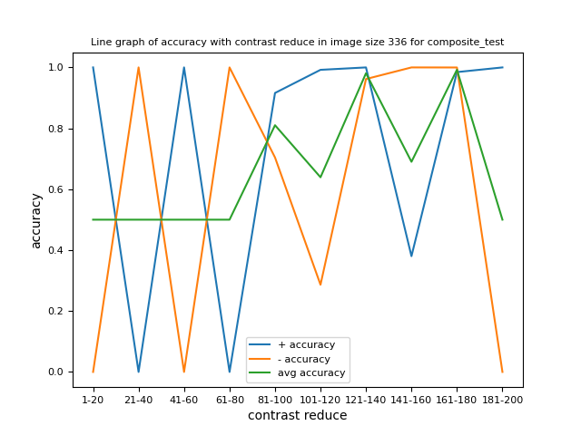
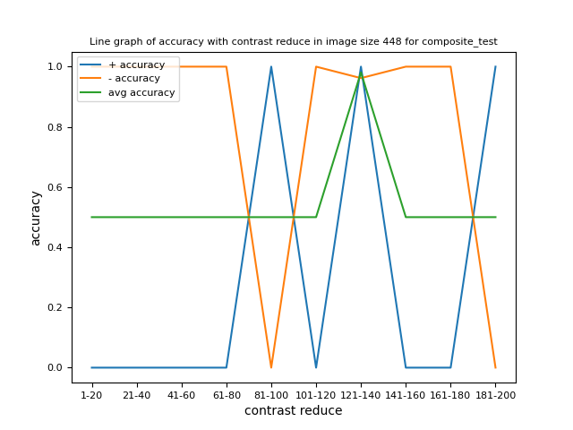
Composite test trend with different contrast reduce for different image sizes
It tends to have high accuracy for all contrast when image size is 56*56 for composite test. (The highlighted graph)
When image size increases, lower contract (closer to 121-140) tends to have higher accuracy.
When image size decrease, higher contract tends to have lower accuracy.

Slide 25
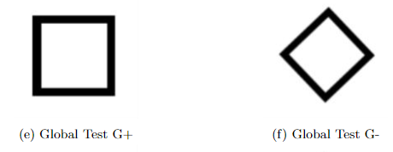








Global test trend with different contrast reduce for different image sizes
It tends to have high accuracy for all contrast when image size is 56*56 or 112*112 for global test. (The highlighted graphs)
When image size increases, lower contract (closer to 121-140) tends to have higher accuracy.
When image size decrease, higher contract tends to have lower accuracy.

Slide 26
Trend with different image sizes
Compare between different contrast reduce

Slide 27










Learning test trend with different image sizes for different contrast reduce

Slide 28










Composite test trend with different image sizes for different contrast reduce

Slide 29










Global test trend with different image sizes for different contrast reduce

Slide 30
Training Data Sample for Different Contrast

Slide 31






Contrast reduce 1-20

Slide 32






Contrast reduce 21-40

Slide 33






Contrast reduce 41-60

Slide 34






Contrast reduce 61-80

Slide 35






Contrast reduce 81-100

Slide 36






Contrast reduce 101-120

Slide 37






Contrast reduce 121-140
Contrast reduce 121-140 has the lowest contract.

Slide 38






Contrast reduce 141-160

Slide 39






Contrast reduce 161-180

Slide 40






Contrast reduce 181-200

Slide 41
Training Data Sample for Different Contrast
Test with different data setting
Trend with different image sizes

Slide 42








Training image size 224
Training contrast reduce 1-20
Part whole test
When the model has low accuracy with the same test dataset, different test sets neither have high accuracy
Seems the model didn’t learn global feature enough, so none of the contrast have high accuracy

Slide 43








Training image size 224
Training contrast reduce 1-20
Part whole flip test
When the model has low accuracy with the same test dataset, different test sets neither have high accuracy
Seems the model didn’t learn global feature enough, so none of the contrast have high accuracy
Part whole test and part whole flip test didn’t show opposite result
Training Data Sample for Different Contrast

Slide 44








Training image size 56
Training contrast reduce 1-20
Part whole test
When the model has high accuracy for same test set, tests with similar contrast and different image size also tend to have high accuracy
Training Data Sample for Different Contrast

Slide 45








Training image size 56
Training contrast reduce 1-20
Part whole flip test
When the model has high accuracy for same test set, tests with similar contract and different image size also tend to have high accuracy
Part whole test and part whole flip test didn’t show opposite result

Slide 46








Training image size 224
Training contrast reduce 121-140
Part whole test
When the model has high accuracy for same test set, tests with similar contrast also tend to have high accuracy for different image size

Slide 47








Training image size 224
Training contrast reduce 121-140
Part whole flip test
When the model has high accuracy for same test set, tests with similar contrast also tend to have high accuracy for different image size
Part whole test and part whole flip test didn’t show opposite result

Slide 48








Training image size 56
Training contrast reduce 121-140
Part whole test
When the model has high accuracy for same test set, tests with similar contrast also tend to have high accuracy for different image size

Slide 49








Training image size 56
Training contrast reduce 121-140
Part whole flip test
When the model has high accuracy for same test set, tests with similar contrast also tend to have high accuracy for different image size
Part whole test and part whole flip test didn’t show opposite result

Slide 50
Training Data Sample for Different Contrast
Test with different data setting
Trend with different contrast reduce

Slide 51










Training image size 224
Training contrast reduce 1-20
Part whole test
When the model has low accuracy with the same test dataset, different test sets neither have high accuracy
Seems the model didn’t learn global feature enough, so none of the contrast have high accuracy

Slide 52










Training image size 224
Training contrast reduce 1-20
Part whole flip test
When the model has low accuracy with the same test dataset, different test sets neither have high accuracy
Seems the model didn’t learn global feature enough, so none of the contrast have high accuracy
Part whole test and part whole flip test didn’t show opposite result

Slide 53










Training image size 224
Training contrast reduce 121-140
Part whole test
When the model has high accuracy for same test set, tests with similar contract also tend to have high accuracy for different image size

Slide 54










Training image size 224
Training contrast reduce 121-140
Part whole flip test
When the model has high accuracy for same test set, tests with similar contract also tend to have high accuracy for different image size
Part whole test and part whole flip test didn’t show opposite result

Slide 55










Training image size 56
Training contrast reduce 1-20
Part whole test
When the model has high accuracy for same test set, tests with similar contrast also tend to have high accuracy for different image size
Part whole test and part whole flip test didn’t show opposite result

Slide 56
Training image size 56
Training contrast reduce 1-20
Part whole flip test
When the model has high accuracy for same test set, tests with similar contrast also tend to have high accuracy for different image size
Part whole test and part whole flip test didn’t show opposite result

Slide 57










Training image size 56
Training contrast reduce 121-140
Part whole test
When the model has high accuracy for same test set, tests with similar contrast also tend to have high accuracy for different image size (highlighted)
Part whole test and part whole flip test didn’t show opposite result

Slide 58










Training image size 56
Training contrast reduce 121-140
Part whole flip test
When the model has high accuracy for same test set, tests with similar contrast also tend to have high accuracy for different image size (highlighted)
Part whole test and part whole flip test didn’t show opposite result

Slide 59
Occlusion test
with different image sizes

Slide 60












learning_occ_test
s_plus_occ
s_min_occ
Training Data Sample for Different Contrast

Slide 61












one_test
s_plus_one
s_min_one
Training Data Sample for Different Contrast

Slide 62











part_whole_occ_test
s_plus_occ
g_min_l_plus_occ
Training Data Sample for Different Contrast

Slide 63










part_whole_test

Slide 64












part_whole_flip_occ_test
g_plus_l_min_occ
s_min_occ

Slide 65










part_whole_flip_test

Slide 66
Compare between part whole occ test and part whole flip occ test

Slide 67
Compare with different image sizes
s_plus_occ
g_min_l_plus_occ
g_plus_l_min_occ
s_min_occ
part_whole_occ_test
part_whole_flip_occ_test
Image pixel values are binary, either 0 or 255.
Contrast reduce 1-20 means when pixel value equals to 255, it deducts a random integer between 1 and 20.
When pixel value equals to 0, it adds a random integer between 1 and 20.
Image sizes include 7*7, 14*14, 28*28, 56*56, 112*112, 224*224, 336*336 and 448*448.

Slide 68
Compare with different image sizes
s_plus_occ
g_min_l_plus_occ
g_plus_l_min_occ
s_min_occ
part_whole_occ_test
part_whole_flip_occ_test
Image pixel values are binary, either 0 or 255.
Contrast reduce 1-20 means when pixel value equals to 255, it deducts a random integer between 1 and 20.
When pixel value equals to 0, it adds a random integer between 1 and 20.
Image sizes include 7*7, 14*14, 28*28, 56*56, 112*112, 224*224, 336*336 and 448*448.

Slide 69
Compare with different image sizes
s_plus_occ
g_min_l_plus_occ
g_plus_l_min_occ
s_min_occ
part_whole_occ_test
part_whole_flip_occ_test
Image pixel values are binary, either 0 or 255.
Contrast reduce 1-20 means when pixel value equals to 255, it deducts a random integer between 1 and 20.
When pixel value equals to 0, it adds a random integer between 1 and 20.
Image sizes include 7*7, 14*14, 28*28, 56*56, 112*112, 224*224, 336*336 and 448*448.

Slide 70
Compare with different image sizes
s_plus_occ
g_min_l_plus_occ
g_plus_l_min_occ
s_min_occ
part_whole_occ_test
part_whole_flip_occ_test
Image pixel values are binary, either 0 or 255.
Contrast reduce 1-20 means when pixel value equals to 255, it deducts a random integer between 1 and 20.
When pixel value equals to 0, it adds a random integer between 1 and 20.
Image sizes include 7*7, 14*14, 28*28, 56*56, 112*112, 224*224, 336*336 and 448*448.

Slide 71
Compare with different image sizes
s_plus_occ
g_min_l_plus_occ
g_plus_l_min_occ
s_min_occ
part_whole_occ_test
part_whole_flip_occ_test
Image pixel values are binary, either 0 or 255.
Contrast reduce 1-20 means when pixel value equals to 255, it deducts a random integer between 1 and 20.
When pixel value equals to 0, it adds a random integer between 1 and 20.
Image sizes include 7*7, 14*14, 28*28, 56*56, 112*112, 224*224, 336*336 and 448*448.

Slide 72
Compare with different image sizes
s_plus_occ
g_min_l_plus_occ
g_plus_l_min_occ
s_min_occ
part_whole_occ_test
part_whole_flip_occ_test
Image pixel values are binary, either 0 or 255.
Contrast reduce 1-20 means when pixel value equals to 255, it deducts a random integer between 1 and 20.
When pixel value equals to 0, it adds a random integer between 1 and 20.
Image sizes include 7*7, 14*14, 28*28, 56*56, 112*112, 224*224, 336*336 and 448*448.

Slide 73
Compare with different image sizes
s_plus_occ
g_min_l_plus_occ
g_plus_l_min_occ
s_min_occ
part_whole_occ_test
part_whole_flip_occ_test
Image pixel values are binary, either 0 or 255.
Contrast reduce 1-20 means when pixel value equals to 255, it deducts a random integer between 1 and 20.
When pixel value equals to 0, it adds a random integer between 1 and 20.
Image sizes include 7*7, 14*14, 28*28, 56*56, 112*112, 224*224, 336*336 and 448*448.

Slide 74
Compare with different image sizes
s_plus_occ
g_min_l_plus_occ
g_plus_l_min_occ
s_min_occ
part_whole_occ_test
part_whole_flip_occ_test
Image pixel values are binary, either 0 or 255.
Contrast reduce 1-20 means when pixel value equals to 255, it deducts a random integer between 1 and 20.
When pixel value equals to 0, it adds a random integer between 1 and 20.
Image sizes include 7*7, 14*14, 28*28, 56*56, 112*112, 224*224, 336*336 and 448*448.

Slide 75
Compare with different image sizes
s_plus_occ
g_min_l_plus_occ
g_plus_l_min_occ
s_min_occ
part_whole_occ_test
part_whole_flip_occ_test
Image pixel values are binary, either 0 or 255.
Contrast reduce 1-20 means when pixel value equals to 255, it deducts a random integer between 1 and 20.
When pixel value equals to 0, it adds a random integer between 1 and 20.
Image sizes include 7*7, 14*14, 28*28, 56*56, 112*112, 224*224, 336*336 and 448*448.

Slide 76
Compare with different image sizes
s_plus_occ
g_min_l_plus_occ
g_plus_l_min_occ
s_min_occ
part_whole_occ_test
part_whole_flip_occ_test
Image pixel values are binary, either 0 or 255.
Contrast reduce 1-20 means when pixel value equals to 255, it deducts a random integer between 1 and 20.
When pixel value equals to 0, it adds a random integer between 1 and 20.
Image sizes include 7*7, 14*14, 28*28, 56*56, 112*112, 224*224, 336*336 and 448*448.

Slide 77
Occlusion test
with different contrast reduce

Slide 78


Compare with different contrast reduce
s_plus_occ
g_min_l_plus_occ
g_plus_l_min_occ
s_min_occ
part_whole_occ_test
part_whole_flip_occ_test
Contrast reduce 121-140 has the lowest contrast
Trend is similar when image size is smaller than 56*56

Slide 79


Compare with different contrast reduce
s_plus_occ
g_min_l_plus_occ
g_plus_l_min_occ
s_min_occ
part_whole_occ_test
part_whole_flip_occ_test
Contrast reduce 121-140 has the lowest contrast
Trend is similar when image size is smaller than 56*56

Slide 80


Compare with different contrast reduce
s_plus_occ
g_min_l_plus_occ
g_plus_l_min_occ
s_min_occ
part_whole_occ_test
part_whole_flip_occ_test
Contrast reduce 121-140 has the lowest contrast
Trend is similar when image size is smaller than 56*56

Slide 81


Compare with different contrast reduce
s_plus_occ
g_min_l_plus_occ
g_plus_l_min_occ
s_min_occ
part_whole_occ_test
part_whole_flip_occ_test
Contrast reduce 121-140 has the lowest contrast

Slide 82


Compare with different contrast reduce
s_plus_occ
g_min_l_plus_occ
g_plus_l_min_occ
s_min_occ
part_whole_occ_test
part_whole_flip_occ_test
Contrast reduce 121-140 has the lowest contrast
Opposite classification shows when image is larger than 112

Slide 83


Compare with different contrast reduce
s_plus_occ
g_min_l_plus_occ
g_plus_l_min_occ
s_min_occ
part_whole_occ_test
part_whole_flip_occ_test
Contrast reduce 121-140 has the lowest contrast
Opposite classification shows when image is larger than 112

Slide 84


Compare with different contrast reduce
s_plus_occ
g_min_l_plus_occ
g_plus_l_min_occ
s_min_occ
part_whole_occ_test
part_whole_flip_occ_test
Contrast reduce 121-140 has the lowest contrast
Opposite classification shows when image is larger than 112

Slide 85


Compare with different contrast reduce
s_plus_occ
g_min_l_plus_occ
g_plus_l_min_occ
s_min_occ
part_whole_occ_test
part_whole_flip_occ_test
Contrast reduce 121-140 has the lowest contrast
Opposite classification shows when image is larger than 112

Slide 86
Training Data Sample for Different Contrast
Weights Visualization for testing data

Slide 87


















































Training image size 224
Training contrast reduce 121-140
Testing image size 224
Testing contrast reduce 0
Part whole test
Classified according to local feature
All classified as class 0 +
Weights on class 0 +
Weights on class 1 -
Weights on class 0 +
Weights on class 1 -
Cam Grayscale
Cam Heatmap
Cam Grayscale
Cam Grayscale
Cam Grayscale
Cam Heatmap
Cam On Image
Cam Heatmap
Cam On Image
Cam Heatmap
Cam On Image
Cam On Image
layer1
layer1
layer2
layer2
layer3
layer3
layer4
layer4

Slide 88


















































Training image size 224
Training contrast reduce 121-140
Testing image size 224
Testing contrast reduce 121-140
Part whole test
Classified according to global feature
Weights on class 0 +
Weights on class 1 -
Weights on class 0 +
Weights on class 1 -
Cam Grayscale
Cam Heatmap
Cam Grayscale
Cam On Image
Cam Heatmap
Cam On Image
Cam Grayscale
Cam Heatmap
Cam Grayscale
Cam Heatmap
Cam On Image
Cam On Image
layer1
layer1
layer2
layer2
layer3
layer3
layer4
layer4

Slide 89
















































Training image size 224
Training contrast reduce 1-20
Testing image size 224
Testing contrast reduce 0
Part whole test
Classified according to local feature
All classified as class 0 +
Weights on class 0 +
Weights on class 1 -
Weights on class 0 +
Weights on class 1 -
Cam Grayscale
Cam Heatmap
Cam Grayscale
Cam Grayscale
Cam Grayscale
Cam Heatmap
Cam On Image
Cam Heatmap
Cam On Image
Cam Heatmap
Cam On Image
Cam On Image
layer1
layer1
layer2
layer2
layer3
layer3
layer4
layer4

Slide 90
















































Training image size 224
Training contrast reduce 1-20
Testing image size 224
Testing contrast reduce 121-140
Part whole test
All classified as class 1 -
Weights on class 0 +
Weights on class 1 -
Weights on class 0 +
Weights on class 1 -
Cam Grayscale
Cam Heatmap
Cam Grayscale
Cam On Image
Cam Heatmap
Cam On Image
Cam Grayscale
Cam Heatmap
Cam Grayscale
Cam Heatmap
Cam On Image
Cam On Image
layer1
layer1
layer2
layer2
layer3
layer3
layer4
layer4

Slide 91
Training Data Sample for Different Contrast
Weights Visualization for training epoch

Slide 92
Training image size 224
Training contrast reduce 1-20
Images for each epoch 10
Epoch 7/14
----------
train Loss: 0.1020 Acc: 1.0000
valid Loss: 0.8366 Acc: 0.5000
Epoch 8/14
----------
train Loss: 0.2883 Acc: 0.8500
valid Loss: 0.7808 Acc: 0.5000
Epoch 9/14
----------
train Loss: 0.0846 Acc: 1.0000
valid Loss: 0.6682 Acc: 0.5500
Epoch 10/14
----------
train Loss: 0.1084 Acc: 1.0000
valid Loss: 0.4900 Acc: 0.6000
Epoch 11/14
----------
train Loss: 0.0837 Acc: 1.0000
valid Loss: 0.3313 Acc: 0.8500
Epoch 12/14
----------
train Loss: 0.1208 Acc: 1.0000
valid Loss: 0.2472 Acc: 0.9000
Epoch 13/14
----------
train Loss: 0.1130 Acc: 1.0000
valid Loss: 0.2015 Acc: 0.9500
Epoch 14/14
----------
train Loss: 0.0423 Acc: 1.0000
valid Loss: 0.1831 Acc: 1.0000
Epoch 0/14
----------
train Loss: 0.7301 Acc: 0.5000
valid Loss: 0.6970 Acc: 0.5000
Epoch 1/14
----------
train Loss: 0.7495 Acc: 0.5500
valid Loss: 0.7012 Acc: 0.5000
Epoch 2/14
----------
train Loss: 0.6168 Acc: 0.6500
valid Loss: 0.6973 Acc: 0.5000
Epoch 3/14
----------
train Loss: 0.6540 Acc: 0.6000
valid Loss: 0.7438 Acc: 0.5000
Epoch 4/14
----------
train Loss: 0.3446 Acc: 0.9500
valid Loss: 0.7817 Acc: 0.5000
Epoch 5/14
----------
train Loss: 0.2234 Acc: 1.0000
valid Loss: 0.7793 Acc: 0.5000
Epoch 6/14
----------
train Loss: 0.1651 Acc: 1.0000
valid Loss: 0.8221 Acc: 0.5000

Slide 93




































s_plus_class0
resnet18_is224_bs4_e15_i10_resize0.5_contrastReduce1-20_num_image10.pth
Epoch 1
Epoch 10
Epoch 15
layer1
layer2
layer3
layer4

Slide 94




































s_min_class1
resnet18_is224_bs4_e15_i10_resize0.5_contrastReduce1-20_num_image10.pth
Epoch 1
Epoch 10
Epoch 15
layer1
layer2
layer3
layer4

Slide 95
Train with one triangle and test on multiple

Slide 96






Training data
Testing data
When image size is large (112 and 224), model tends to classify according to local feature.
Both are classified as 0 +
s_plus_one
s_min_one

Slide 97






Training data
Testing data
When image size is large (112 and 224), model tends to classify according to local feature
Both are classified as 0 +
s_plus_one
s_min_one
Training Data Sample for Different Contrast

Slide 98






Training data
Testing data
When image size is large (112 and 224) and contrast is high (1-20 and 181-200), model tends to classify according to local feature
s_plus_one
s_min_one

Slide 99
Training Data Sample for Different Contrast
Weights Visualization for different position

Slide 100


















































Training image size 224
Training contrast reduce 1-20
Testing image size 224
Testing contrast reduce 1-20
Part whole test
Weights on class 0 +
Weights on class 1 -
Weights on class 0 +
Weights on class 1 -
Cam Grayscale
Cam Heatmap
Cam On Image
layer1
layer1
layer2
layer2
layer3
layer3
layer4
layer4

Slide 101


















































Training image size 224
Training contrast reduce 1-20
Testing image size 224
Testing contrast reduce 0
Part whole test
Weights on class 0 +
Weights on class 1 -
Weights on class 0 +
Weights on class 1 -
Cam Grayscale
Cam Heatmap
Cam On Image
layer1
layer1
layer2
layer2
layer3
layer3
layer4
layer4

Slide 102






models\resnet18_is224_bs4_e10_i10000_resize0.5_contrastReduce121-140_num_image10000.pth
images_resize0.5_contrastReduce121-140_num_image10000\part_whole_test\0\s_plus+3.png
layer3
((1.0, 0, '0_plus'), (4.554557e-08, 1, '1_min'))

Slide 103





models\resnet18_is224_bs4_e10_i10000_resize0.5_contrastReduce121-140_num_image10000.pth
images_resize0.5_contrastReduce121-140_num_image10000\part_whole_test\0\s_plus+9.png
layer3
((0.9999999, 0, '0_plus'), (1.127485e-07, 1, '1_min'))

Slide 104





models\resnet18_is224_bs4_e10_i10000_resize0.5_contrastReduce121-140_num_image10000.pth
images_resize0.5_contrastReduce121-140_num_image10000\part_whole_test\1\g_min_l_plus+4.png
layer3
((0.99999046, 1, '1_min'), (9.51215e-06, 0, '0_plus'))

Slide 105





models\resnet18_is224_bs4_e10_i10000_resize0.5_contrastReduce121-140_num_image10000.pth
images_resize0.5_contrastReduce121-140_num_image10000\part_whole_test\1\g_min_l_plus+9.png
layer3
((0.99999, 1, '1_min'), (1.0055743e-05, 0, '0_plus'))

Slide 106





models\resnet18_is224_bs4_e10_i10000_resize0.5_contrastReduce1-20_num_image10000.pth
images_resize0.5_contrastReduce1-20_num_image10000\part_whole_test\0\s_plus+1.png
layer3
((0.9999999, 0, '0_plus'), (1.6243001e-07, 1, '1_min'))

Slide 107





models\resnet18_is224_bs4_e10_i10000_resize0.5_contrastReduce1-20_num_image10000.pth
images_resize0.5_contrastReduce1-20_num_image10000\part_whole_test\0\s_plus+9.png
layer3
((0.9999987, 0, '0_plus'), (1.2689698e-06, 1, '1_min'))

Slide 108





models\resnet18_is224_bs4_e10_i10000_resize0.5_contrastReduce1-20_num_image10000.pth
images_resize0.5_contrastReduce1-20_num_image10000\part_whole_test\1\g_min_l_plus+0.png
layer3
((0.98573005, 0, '0_plus'), (0.014270004, 1, '1_min'))

Slide 109





models\resnet18_is224_bs4_e10_i10000_resize0.5_contrastReduce1-20_num_image10000.pth
images_resize0.5_contrastReduce1-20_num_image10000\part_whole_test\1\g_min_l_plus+8.png
layer3
((0.9999987, 0, '0_plus'), (1.2689698e-06, 1, '1_min'))

Slide 110




models\resnet18_is224_bs4_e10_i10000_resize0.5_contrastReduce1-20_num_image10000.pth
images_resize0.5_contrastReduce1-20_num_image10000\part_whole_flip_test\0\g_plus_l_min+1.png
layer3
((0.99999905, 1, '1_min'), (1.0058668e-06, 0, '0_plus'))

Slide 111





models\resnet18_is224_bs4_e10_i10000_resize0.5_contrastReduce1-20_num_image10000.pth
images_resize0.5_contrastReduce1-20_num_image10000\part_whole_flip_test\0\g_plus_l_min+2.png
layer3
((0.99999404, 1, '1_min'), (5.9321937e-06, 0, '0_plus'))

Slide 112





models\resnet18_is224_bs4_e10_i10000_resize0.5_contrastReduce1-20_num_image10000.pth
images_resize0.5_contrastReduce1-20_num_image10000\part_whole_flip_test\1\s_min+1.png
layer3
((0.999969, 1, '1_min'), (3.095544e-05, 0, '0_plus'))

Slide 113





models\resnet18_is224_bs4_e10_i10000_resize0.5_contrastReduce1-20_num_image10000.pth
images_resize0.5_contrastReduce1-20_num_image10000\part_whole_flip_test\0\g_plus_l_min+3.png
layer3
((0.99999964, 1, '1_min'), (3.7750615e-07, 0, '0_plus'))

Slide 114


models\resnet18_is224_bs4_e10_i10000_resize0.5_contrastReduce121-140_num_image10000.pth
images_resize0.5_contrastReduce121-140_num_image10000\part_whole_test\

Slide 115
Training Data Sample for Different Contrast

